Slide 1


REPORT
Ted video
website
reporter：杨冬宁

Slide 2
CONTENTS
Program design
Program function
Problems encountered
Division of work

Slide 3
PART 01
Program design

Slide 4
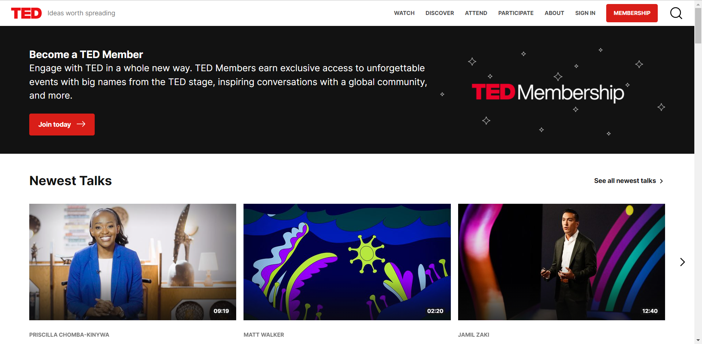
Program design
Notes:
TED is a video website. The videos on it cover all aspects, which can expand viewers horizon. Besides, the speeches are almost given by native speakers. They’re good listening materials.
However, it’s an oversea website. That means it takes a lot of time to wait for it loading and it’s unstable. Besides, it has ads.
So we think why not collect the information of the videos and create our own website?

Slide 5
PART 02
Program function

Slide 6
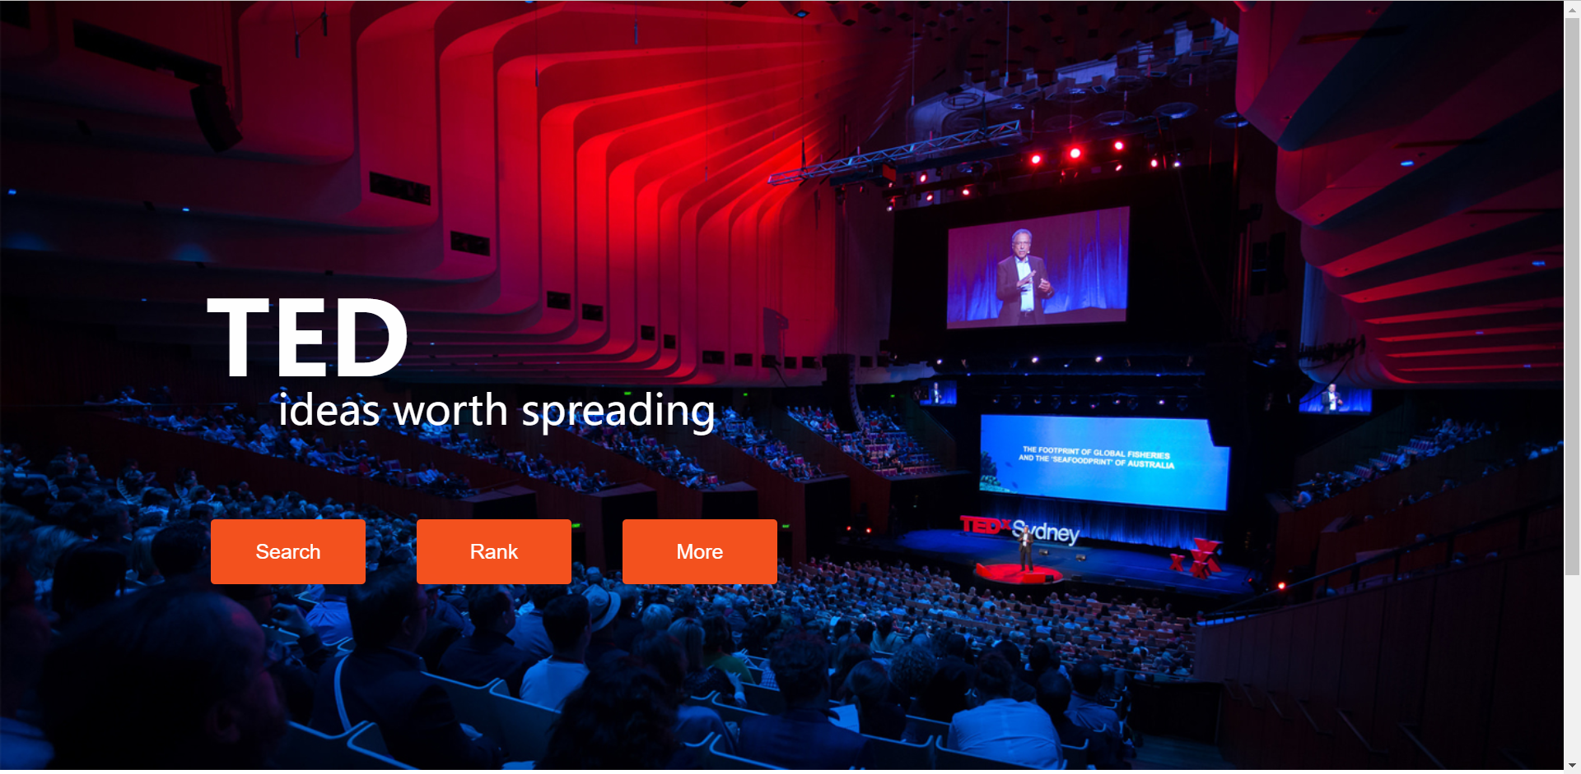
Program function
rank
search
more
Notes:
The main function of the website features searching, ranking and some other small function.
It support searching for the video by title, author, author’s profession, introduction and tags.
On the rank page, it list top 5 most-viewed videos.
What’s more, it visualize the information of those videos.

Slide 7
PART 03
Problems encountered

Slide 8
Problem encountered
1.The crawler program runs too slow.
2.Access to database for everyone.
3.A Muti-term and Muti-field Supporting Search Engine
4.The Webpage's Interface with Search Engine
5.The Beautification of Webpage
6. Parameter Transmission of Parallel Search

Slide 9
PART 04
Division of work

Slide 10
Division of work
Crawling & database
戴语彤
Searching engine
杨冬宁
visualization
申艾瑶
website
葛媛 俞快

Slide 11
exhibition
Please watch the exhibition

Slide 12
REPORT
感谢观看与指导

